Slide 1

Chat Bot Development

Slide 2
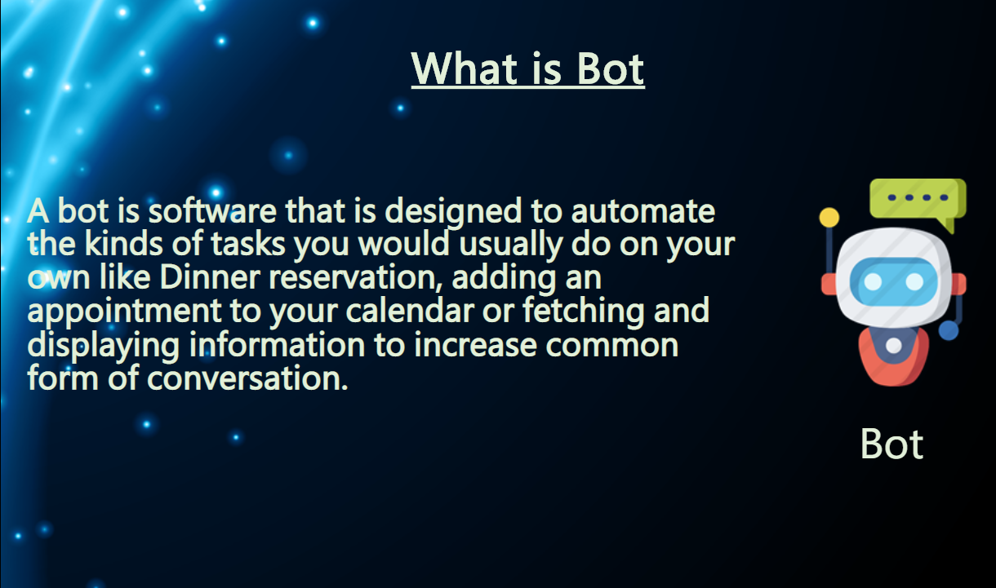

Slide 3


Slide 4
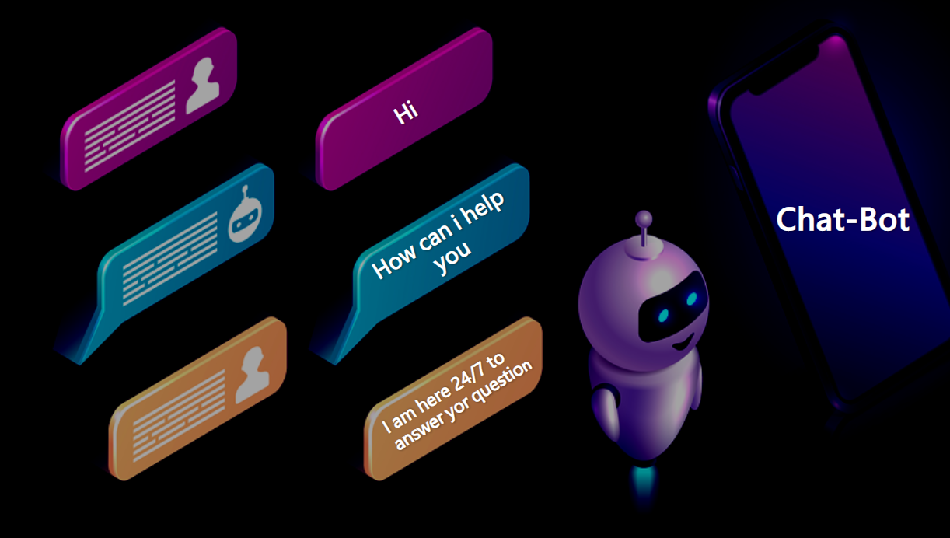
SOLUTIONS OF THE ABOVE PROBLEM ARE:
SOCIAL DISTANCING
WASH YOUR HANDS REGULARLY
STAY AT HOME

Slide 5



TECHNOLOGY USED

Slide 6
